Slide 1

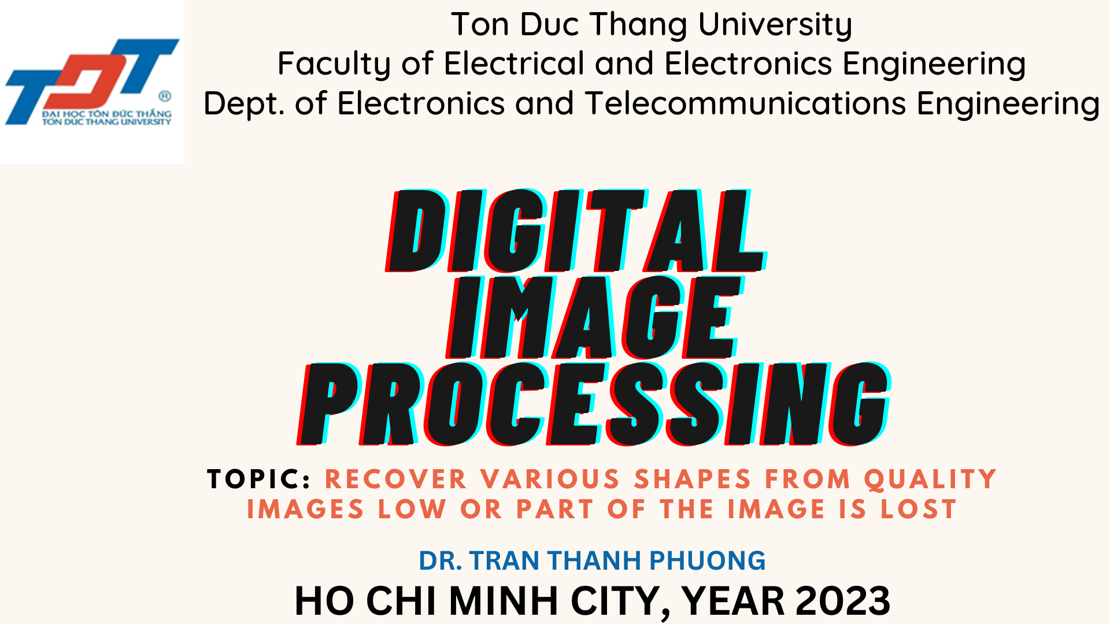
Ton Duc Thang University
Faculty of Electrical and Electronics Engineering
Dept. of Electronics and Telecommunications Engineering
DIGITAL
IMAGE
PROCESSING
TOPIC: RECOVER VARIOUS SHAPES FROM QUALITY IMAGES LOW OR PART OF THE IMAGE IS LOST
DR. TRAN THANH PHUONG
HO CHI MINH CITY, YEAR 2023

Slide 2

File
Edit
Format
View
DR. TRAN THANH PHUONG
Group 1 _ Topic 1
B
I
U
Recover various shapes from quality images low or part of the image is lost

Slide 3




GROUP MEMBER
1
2
3
4
NGUYEN DUC TRI
41900297
NGO NGUYEN MINH HUY
419H0106
TRAN HAI DANG
419H0020
PHAN DINH DAT
418H0027

Slide 4



Table of Contents
Section
1
Section 2
Section 3

Slide 5



Section 1

Slide 6
Group1presentation.com/What_is_the_error-image?
Blur photos
Low quality photos
Losing parts of photos

Slide 7
Page 2
GROUP 1'S PRESENTATION
THE REASON FOR THESE ERROR
Outside the lens's focal area, using a lens with a wide angle, environmental turbulence, short exposure time... will reduce the number of captured photons.
Movement during image capture:
by a camera or when a large exposure time is used.
by the object.

Slide 8

Page 3
CLASSROOM RULES
ENHANCE CONTRAST TO RESTORE IMAGES
Before

Slide 9

Page 3
CLASSROOM RULES
Before

Slide 10

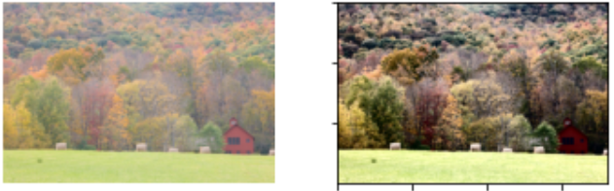
Page 3
CLASSROOM RULES
ENHANCE CONTRAST TO RESTORE IMAGES
Before

Slide 11

Page 4
CLASSROOM RULES
ENHANCE CONTRAST TO RESTORE IMAGES
After

Slide 12
Page 7
CLASSROOM RULES
After

Slide 13

Page 4
CLASSROOM RULES
ENHANCE CONTRAST TO RESTORE IMAGES
After

Slide 14
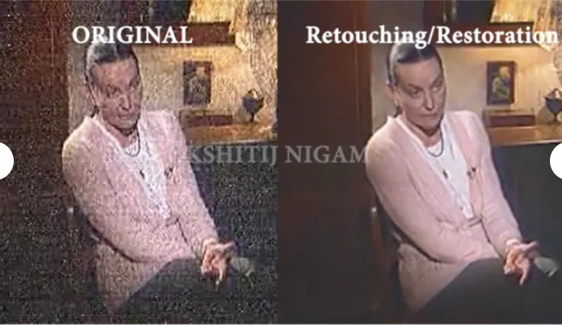
Page 5
GROUP 1'S PRESENTATION
PHOTO RESTORATION THROUGH NOISE REDUCTION
Before

Slide 15
Page 5
GROUP 1'S PRESENTATION
PHOTO RESTORATION THROUGH NOISE REDUCTION
After

Slide 16
Page 6
GROUP 1'S PRESENTATION
MODEL-BASED RESTORATION
1.
RECOVER PHOTOS BY RECONSTRUCTING LOST INFORMATION
INTERPOLATION-BASED RESTORATION
2.

Slide 17
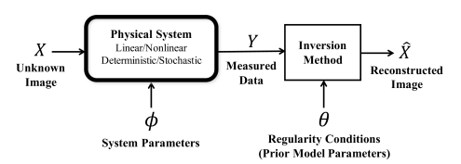
Page 6
GROUP 1'S PRESENTATION
RECOVER PHOTOS BY RECONSTRUCTING LOST INFORMATION
1.
MODEL-BASED RESTORATION
INTERPOLATION-BASED RESTORATION
2.

Slide 18
Page 6
GROUP 1'S PRESENTATION
MODEL-BASED RESTORATION
1.
RECOVER PHOTOS BY RECONSTRUCTING LOST INFORMATION
INTERPOLATION-BASED RESTORATION
2.

Slide 19
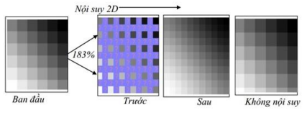
Page 6
GROUP 1'S PRESENTATION
RECOVER PHOTOS BY RECONSTRUCTING LOST INFORMATION
2.
INTERPOLATION-BASED RESTORATION
MODEL-BASED RESTORATION
1.

Slide 20

Page 7
GROUP 1'S PRESENTATION
MODEL-BASED RESTORATION
IMAGE RECOVERY USING IMAGE RECOVERY ALGORITHMS
1.
INTERPOLATION-BASED RESTORATION
2.
SEGMENTATION-BASED RESTORATION
MACHINE LEARNING -BASED RESTORATION
3.
4.

Slide 21
Table of Contents
Section
1
Section 2
Section 3

Slide 22
TOPIC 2

Slide 23

IMAGE
RECOVERY

Slide 24
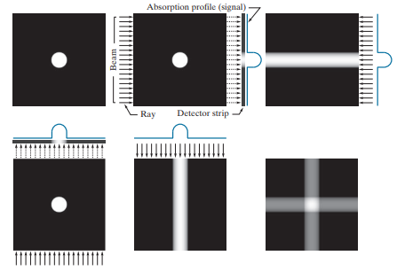
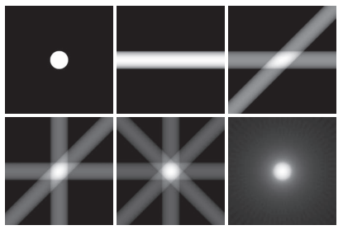
Page 2
GROUP 1'S PRESENTATION
IMAGE RECONSTRUCTION FROM PROJECTIONS

Slide 25
Page 2
GROUP 1'S PRESENTATION
IMAGE RECONSTRUCTION FROM PROJECTIONS

Slide 26
Page 2
GROUP 1'S PRESENTATION
IMAGE RECONSTRUCTION FROM PROJECTIONS

Slide 27
Page 2
GROUP 1'S PRESENTATION
IMAGE RECONSTRUCTION FROM PROJECTIONS

Slide 28
Page 3
GROUP 1'S PRESENTATION
PRINCIPLES OF X-RAY COMPUTED TOMOGRAPHY
founder: Johann Radon
co-founder: Allan M. Cormack
The goal of X-ray computed tomography is to obtain a 3-D representation of the internal structure of an object by X-raying the object from many different directions.

Slide 29
Page 4
CLASSROOM RULES
KNOWLEDGE REVIEW SECTION
1.
Mean Filter
2.
Median Filter
3.
Adaptive Filter
4.
Butterworth Filter
5.
....
ELIMINATE NOISE USING A FILTER

Slide 30
Page 4
CLASSROOM RULES
KNOWLEDGE REVIEW SECTION
Inverse Filtering
1.
Wiener Filtering
2.
RECOVERING THE PICTURE
LOSING PART OF THE PHOTOS
SCRATCHED PHOTOS

Slide 31
Table of Contents
Section
1
Section 2
Section 3

Slide 32
TOPIC 3

Slide 33

SIMULATION

Slide 34
File
Edit
Format
View
DR. TRAN THANH PHUONG'S CLASS
Thank You
For Listening
Do you have any questions for me?

